Slide 1
Object Oriented Programming
Lecture 01 - Revision
Ms. Farah Younas

Slide 2
Time Table
 | Day | Time
1 | Monday | 01:00 - 02:20 (Lab 04)
2 | Friday | 02:00 - 03:50 (203)
 | Consultation | 01 hour

Slide 3
Assessments
Assessment |  | Marks | Frequency | Total
1 | Quiz | 05 | 3 | 15
2 | Assignment | 05 | 3 | 15
3 | Mid Term | 25 | 1 | 30
4 | Mid Term Viva | 05 | 1
5 | Final Term | 30 | 1 | 40
6 | Final Term Viva | 10 | 1
Total Marks |  | 100
Copied or shown assignments/quizzes will be marked zero.
Late submissions are not entertained in any case

Slide 4
Books
Object Oriented Programming in C++, Robert Lafore , 4th Edition, 2002
Reference Books
C++ How to program, Deitel & Deitel, 7 th Edition, Pearson, 2010
Object Oriented Programming with C++, E Balagurusamy, 4 th Edition, 2014
Class Code: 3w6q6u7

Slide 5
Agenda of Lecture
Functions

Slide 6
Introduction to Functions
A complex problem is often easier to solve by dividing it into several smaller parts, each of which can be solved by itself.
This is called structured programming.
These parts are sometimes made into functions in C++.
main() then uses these functions to solve the original problem.

Slide 7
Functions
A function groups a number of program statements into a unit and give it a name.
This unit can be invoked from other parts of the program.

Slide 8
Functions
Why do we use functions?
To aid in the conceptual organization of a program.
To reduce program size.
Any sequence of instructions that appear in a program more than once is a candidate for being made into a function.
The function code is stored in only one place in memory, even though the function is executed many times in the course of a program.

Slide 9
Functions
Functions
Modularize a program
Software reusability
Call function multiple times
Local variables
Known only in the function in which they are defined
All variables declared in function definitions are local variables
Parameters
Local variables passed to function when called
Provide outside information

Slide 10
Advantages of Functions
Functions separate the concept (what is done) from the implementation (how it is done).
Functions make programs easier to understand.
Functions can be called several times in the same program, allowing the code to be reused.

Slide 11
C++ Functions
C++ allows the use of both internal (user-defined) and external functions.
External functions (e.g., abs, ceil, rand, sqrt, etc.) are usually grouped into specialized libraries (e.g., iostream, stdlib, math, etc.)

Slide 12
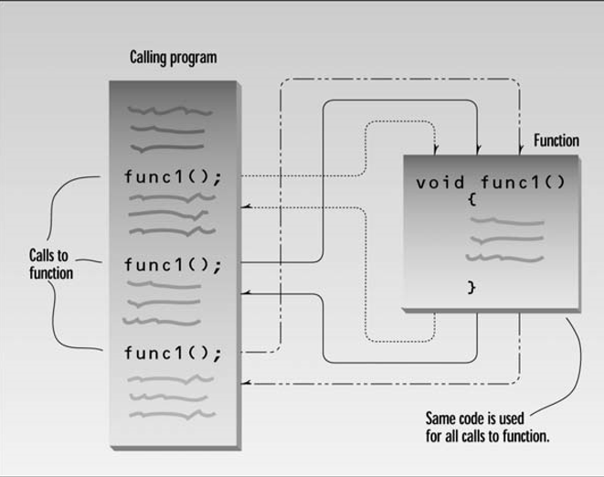
Flow control to a Function

Slide 13
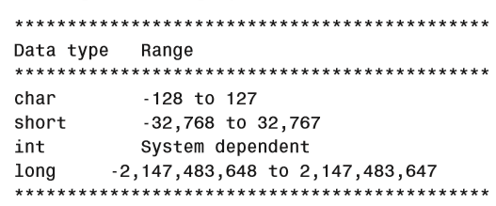
Simple Functions
Creating a simple function whose purpose is to print a line of 45 asterisks.
The example program generates a table, and lines of asterisks are used to make the table more readable

Slide 14
Simple Functions
The program consists of two functions: main() and starline().
There are three components to add :
the function declaration,
the calls to the function,
the function definition.

Slide 15
Questions??

